Slide 1
Welcome to the Lassonde Institute
Scholarships, Reimbursements, Rental and House Rules.

Slide 2
Purchase Items?
- Materials
-Food
- Awards
1. Pre approve all purchases with your director.
If purchase is over $50 you MUST talk with Katie first
2b. Make the purchase and request a reimbursement from Katie
(Make this a last resort)
2a. Arrange purchase of item and then call Katie, she will pay for the item with her pCard.
OR
Do Not have the vendor call me for payment without first
Talking to me
Providing an invoice
Always allow 3 days for processing
Plan ahead!
Awards
I must have the awardees W9 on file
NO GIFTS
The University rules are very strict, talk to me before you purchase gifts
Just remember the motto –
“3 days / $50”
If you plan on spending more than $50 call and talk to me 3 days in advance.

Slide 3
Request a Reimbursement?
1. Fill out a Reimbursement Request form
2. Make sure to provide your W9 to Katie
3. Provide Original reciepts to Katie
4. Sign the form and wait for your Reimbursement
7-14 business days
We cannot reimburse the following items
Anything without the original receipt
Personal meals, supplies etc.
Alcohol
Online memberships (Amazon Prime)
Car payments
Outside contractors (For example: You hired a janitor to clean up after an event. We cannot pay him directly, you will need to pay him and we can reimburse you.
To reimburse mileage you will need
To complete the driver’s training (Contact Katie for more information)
A google map of miles driven
Follow the reimbursement request steps

Slide 4
Need to rent the Lassonde / White house
Lassonde House 604-
Call Mark Barnard at 801-587-2981, tell him you are with the Lassonde group
Whitehouse 602 -
The Whitehouse is co working space
needs to be shared
If you bring food or garbage into either space you must clean it up and take out garbages
You must clean up after selves. If you bring something in, be sure to take it back with you. Do not leave garbage, decorations, or flyers in the building unless you plan to clean it out afterwards.
If you have a catered event, the caterer usually cleans up. This does not apply to food that is delivered. You must remove all trash and take it to the dumpster (behind guesthouse, Northwest side)
No Alcohol at all
Do not have any personal items or supplies delivered to these buildings; speak with Katie for special exceptions.
Be respectful of both 602 and 604, they are historic buildings.
Need printer supplies in bldg. 602? (Call Katie)
All materials and supplies that are to be shared will be labeled as such. Do NOT use, borrow or move things that don’t belong to you.
Need a key made for bldg. 602? (Call Katie)
Must have Troy, Kathy or Anne’s approval
Are there building Maintenance issues in Bldg. 602? (Call Katie)
Heat/AC not working
Lights
Funky Smells
On rare occasions, ghosts.
Have university policy questions? (Call Katie)
Need Forms? (Call Katie)

Slide 5
When in doubt...
Call, email, visit
Katie
Katie Evans
Project Coordinator
Co-Operational FLL Partner
Office Manager
801-585-1496
Katie.Evans@utah.edu
105 Fort Douglas Blvd #604. SLC UT 84113
Hours
M-F 8:00am – 5:00pm
Please call prior to visiting to ensure that I am available

Slide 6
Scholarships
Scholarships are awarded through the business school by Troy, Kathy or Anne.
Typical Undergraduate Budgets 2014-2015
Below is an estimated Cost of Attendance for an Undergraduate student attending fall and spring semesters, with a course load of 13 credit hours per semester. Use this information to estimate what your costs will be.
As of Fall 2014 all scholarship award monies will be first applied to any outstanding tuition debt and any remaining money will be paid to the student up to ‘Cost of Attendance’
The scholarship office will determine your federal aid status.
Scholarship question contact is Tina Redmond credmond@sa.utah.edu
Academic Year 2014-15 | Living On Campus | Living Off Campus | Living With Parent(s)
Room and Board | 10,746 | 8,802 | 2,718
Books and Supplies | 1,280 | 1280 | 1,280
Miscellaneous | 3,996 | 5,040 | 3,996
Transportation | 1,098 | 1,098 | 1,098
Tuition and Fees | Resident: 7,166 Non-Resident: 22,598 | Resident: 7,166 Non-Resident: 22,598 | Resident: 7,166 Non-Resident: 22,598
Total Budget | Resident: $24,360 *Non-Resident: $40,512 | Resident: $23,460 *Non-Resident: $39,612 | Resident: $16,332 *Non-Resident: $32,484
http://financialaid.utah.edu/paying-for-college/cost.php

Slide 7
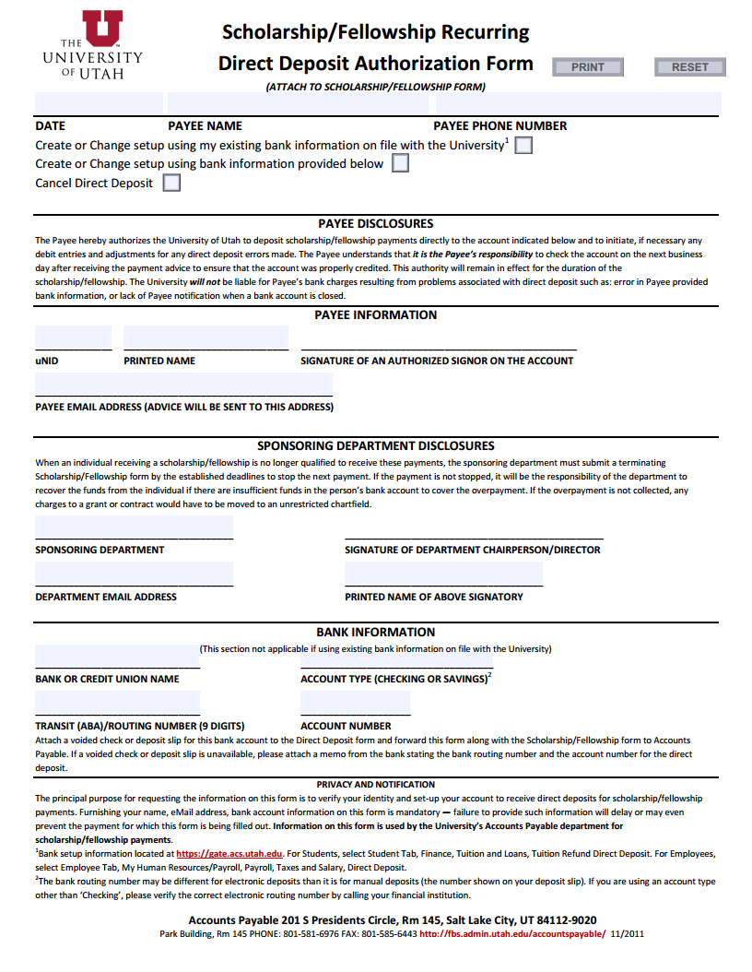
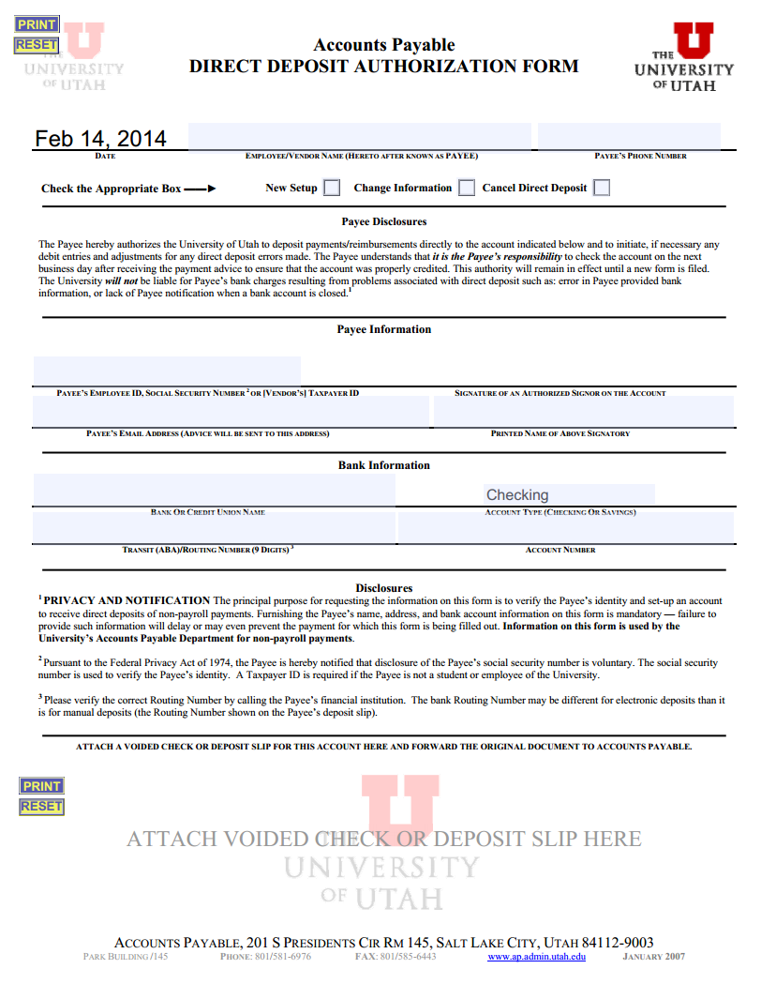
Direct Deposit for scholarship
Forms needed. Can be found at http://fbs.admin.utah.edu/forms-a/#D or through me at katie.evans@utah.edu

Slide 8
Reimbursements
We can reimburse the following items that have been approved by Troy, Kathy or Anne
Food purchased for a student group event (within reason, please avoid Lobster and Kobe Beef)
If the food is purchased for a large student banquet (over $1,000), please contact Katie first. A requisition must be completed prior.
Miles driven on official outreach business (after completing the driver training course)
Printing for events (flyers, posters, etc)
Awards or Gifts presented to speakers and students (there are rules to which kind of gifts you can purchase)
The University of Utah has eCommerce capability for collecting fees. Please contact us for more information.
Do not make a PayPal account to collect registration fees.
We cannot reimburse the following items
Anything without the original receipt
Personal meals, supplies etc.
Alcohol
Online memberships (Amazon Prime)
Car payments
Outside contractors (For example: You hired a janitor to clean up after an event. We cannot pay him directly, you will need to pay him and we can reimburse you.
……There are some rules and policies. When in doubt, ask Katie first!

Slide 9
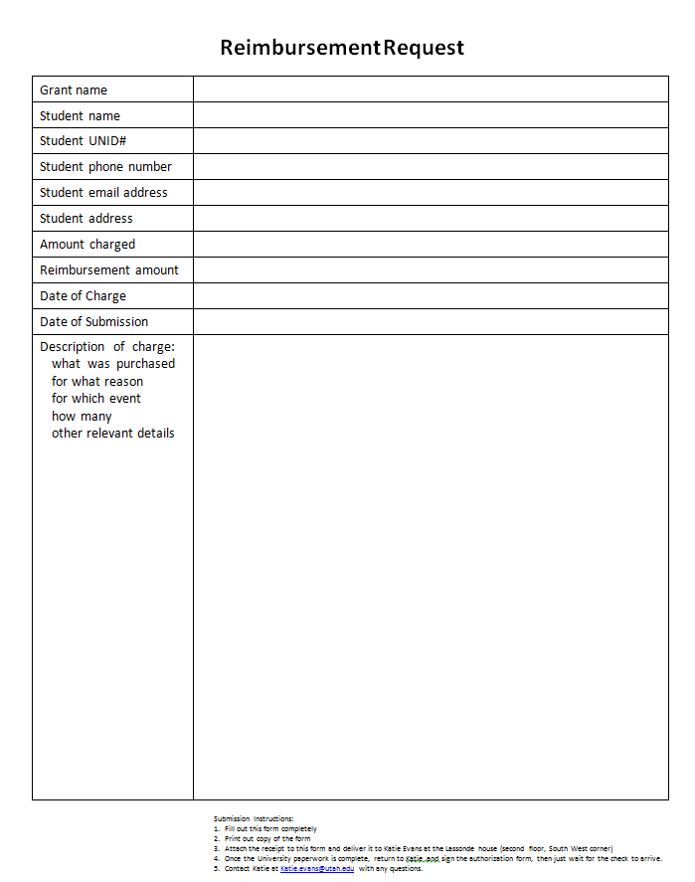
Reimbursement Rules:
Fill out a Reimbursement Request
Student Name
Student UNID#
Student Phone Number
Student Email Address
Student Address
Amount Charged
Reimbursement Amount
Date Charged
Date of Submission
Description of charge.
Include ORIGINAL RECEIPTS
Accounts Payable will not accept copies.
If you have lost your receipt you may turn in a bank statement outlining the charge.
Sign the Payment Request Form
I will create a payment request and will need your signature. I can send this via email and you can sign, scan and return.
Must have a W9 on file for you. http://www.irs.gov/pub/irs-pdf/fw9.pdf

Slide 10
Office of Risk Management - NEW DRIVER TRAINING – Must have to be reimbursed for mileage.
Mileage, Gifts and Awards
All University Drivers Must View The Driver Training Video And Take The Test Every Two Years.
Driver Training Video & Test
Access the Driver Training Video & Test online http://risk.utah.gov/driver-video-and-test1.html
Take the online test, print the "Certificate of Completion" and give a copy to Katie.Evans@utah.edu. I will also need a copy of a valid drivers license.
Under special circumstances as an alternative to the online format, the Driving Video and Test may be obtained in DVD format by contacting the Risk & Insurance Management department at (801)581-5590.
Frequency: Every 2 years

Slide 11
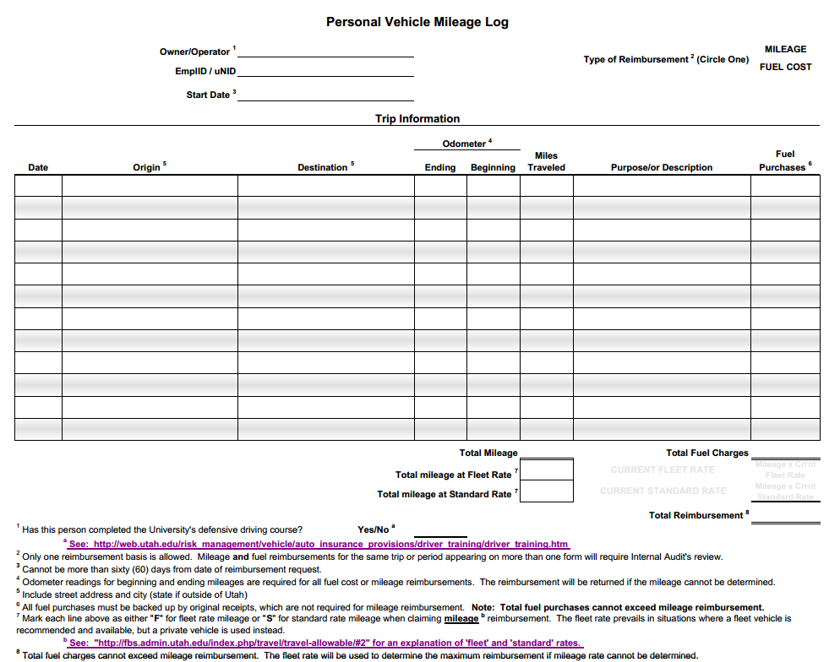
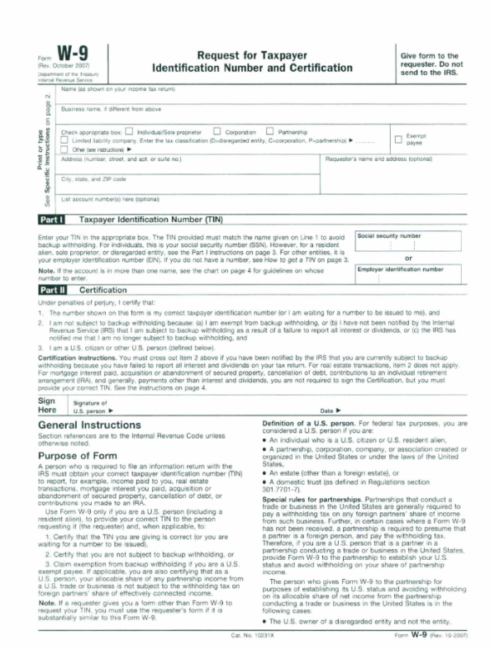
Mileage, Gifts and Awards..
Google Maps to document mileage or a Mileage Log.
ALL Trips must be pre-approved by Troy, Kathy or Anne
2014 mileage reimbursement is $0.56/mile OR you can turn in fuel receipts
AP will only reimburse the cheaper of the two.
The ML form can be obtained online at http://fbs.admin.utah.edu/forms-a/#D or through me at katie.evans@utah.edu
Must Include a map showing the route taken. This can easily be done through GoogleMaps.
Airline tickets, Hotels and Per diems can be obtained for pre - approved trips.
Gifts (NO Pre-Paid Visa Cards, Gift Cards, Headphones without)
Must have SSN/UID, names, explanation and amount.
Must have original receipt
Cash Prizes are off limit. We will not reimburse a cash prize.
Awards (Opportunity Quest, TechTitans, UES)
Must have a W9 on file for all awardees
If on a team, work out if they will split the award or if it goes to one team member. Signed letter confirming.
Must be pre-approved through Troy, Kathy or Anne

Slide 12
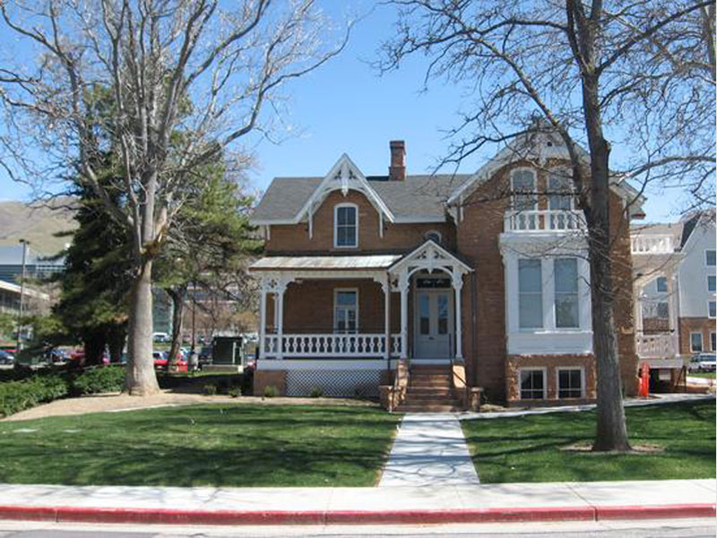
White House
85 Fort Douglas Blvd, # 602
Lassonde House
105 Fort Douglas Blvd, #604
M-F 8am – 5pm
Student Meeting Space
Student co-working space
If locked please call 801-581-8669 or see Katie
M-F 8am-5pm
Administrative Offices
Event Space
Must be reserved through Guest House.

Slide 13
Lassonde House Rental and Rules
Rentals need to be set up through the Guesthouse
Must be pre-approved by Troy, Kathy or Anne.
Call Mark Barnard at 801-587-2981, tell him you are with the Lassonde group.
All invoices are paid by me after the event.
Guesthouse can arrange for chair set up, A/V needs and banquet tables
House Guidelines
You must clean up after selves. If you bring something in, be sure to take it back with you. Do not leave garbage, decorations, or flyers in the building unless you plan to clean it out afterwards.
If you have a catered event, the caterer usually cleans up. This does not apply to food that is delivered. You must remove all trash and take it to the dumpster (behind guesthouse, Northwest side)
No Alcohol at all
Do not have any personal items or supplies delivered to these buildings, speak with Katie for special exceptions.
Be respectful of both 602 and 604, they are historic buildings.
Need printer supplies in bldg. 602? (Call Katie)
All materials and supplies that are to be shared will be labeled as such. Do NOT use, borrow or move things that don’t belong to you.
Need a key made for bldg. 602? (Call Katie)
Must have Troy, Kathy or Anne’s approval
Are there building Maintenance issues in Bldg. 602? (Call Katie)
Heat/AC not working
Lights
Funky Smells
On rare occasions, ghosts.
Have university policy questions? (Call Katie)
Need Forms? (Call Katie)

Slide 14
Contact Info
Katie Evans
801-585-1496
Katie.Evans@utah.edu
105 Fort Douglas Blvd #604. SLC UT 84113
Hours
M-F 8:00am – 5:00pm
Please call prior to visiting to ensure that I am available

