Slide 1
LASSONDE PR / MARKETING
Tips & Resources for Student Programs
UPDATED: 04-09-15

Slide 2
Lassonde PR / Marketing Goals
Make U known for entrepreneurship
Create awareness of the Lassonde Institute and Lassonde Studios
Drive participation in all programs
Drive applications to Lassonde Studios

Slide 3
Ways You Can Help
Learn about Lassonde Institute and Lassonde Studios
Take responsibility for your program marketing
Mention the Lassonde Institute and Lassonde Studios (and the U)
Plan ahead and keep us informed
Follow and support us on social media
Help build our email subscriber list

Slide 4
Ways You Can Help (cont.)
Contribute to Lassonde Institute marketing materials
Help promote our successes
Cross promote and coordinate
Attend the regular marketing meet-ups
Review deadlines checklist
Know resources are available

Slide 5
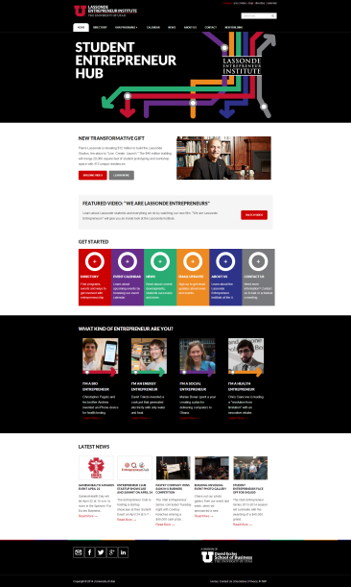
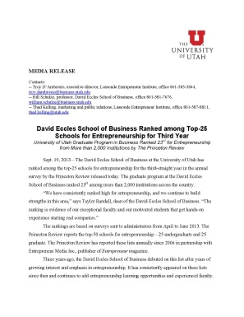
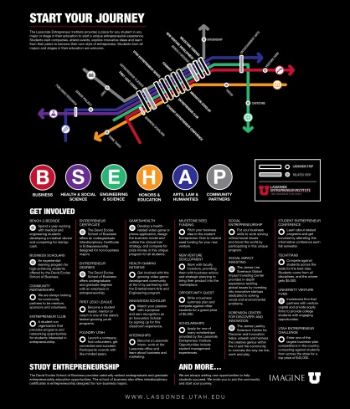
Available Resources
Lassonde website ………………………….
Lassonde Institute collateral …....
Press releases …….
4. Web support

Slide 6
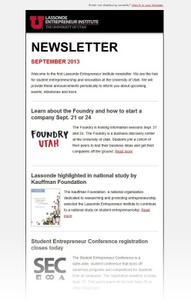
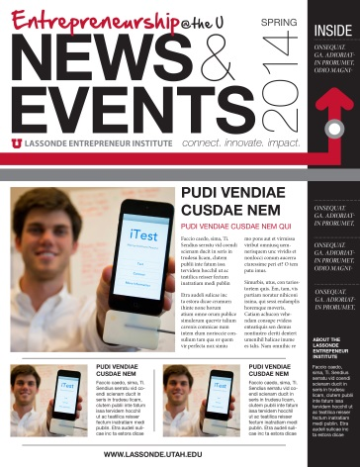
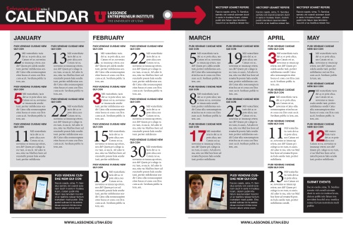
Available Resources (cont.)
Brochure racks ...............................................
6. Email newsletter …………………….
7. Print newsletter ……...
8. Social media

Slide 7
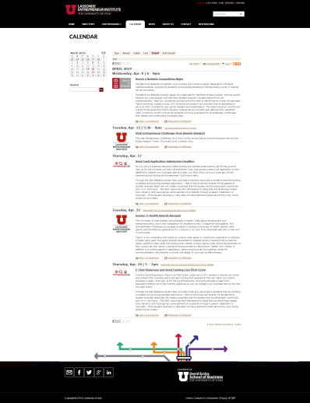
Available Resources (cont.)
10. Online event calendar ………………...
12. Editing / review
13. Let’s talk

