Slide 2
Lassonde Studios
Live. Create. Launch.
The Lassonde Studios will be the nexus for entrepreneurs on the university campus. The Studios will host programs that engage more than 5,000 students annually in the 20,000 sq./ft. “Garage” and provide residences for 400 student entrepreneurs.
Program highlights:
Ranked in the top 25 university program for entrepreneurship for the past three years by Princeton Review/Entrepreneur Magazine
The University of Utah has consistently been ranked among the top institutions for creating startup companies based in university developed technologies (No. 1 in 2008 and 2009, passing MIT). The Lassonde Institute has played a key part this success and has helped start 45 companies
University of Utah student startups are creating jobs and millions of dollars in revenue, have appeared on NBC’s Shark Tank, and have won local and national business plan competitions, including the Department of Energy’s CleanTech Open, the Carnegie Mellon Life Science Contest and the Utah Entrepreneur Challenge

Slide 3
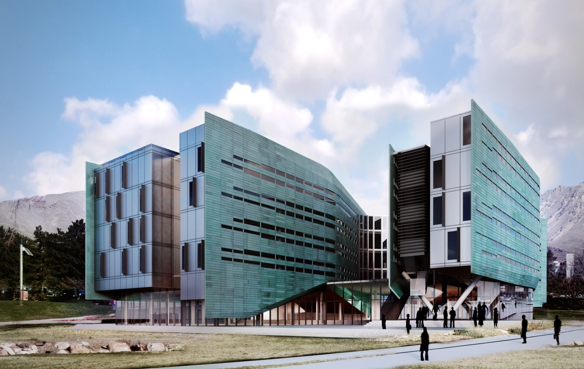
Lassonde Studios

Slide 4
Knowledge Studios
Knowledge Studios are
entrepreneurial focused student programs using student mentors in themed spaces in the student garage and residential floors
Knowledge Studio types
Co-working space
Company launch space
Fabrication/prototyping space
Digital media
Maker space

Slide 5
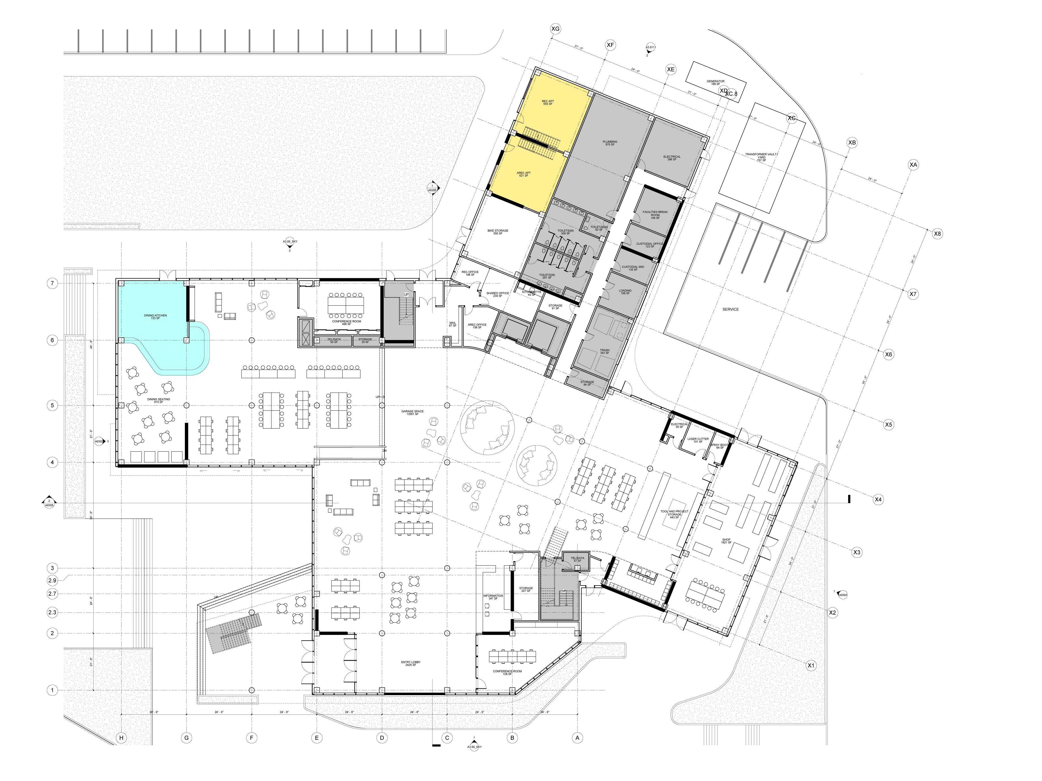
Knowledge Studios in the Garage
Co-working
Events
Fabrication/assembly
Company launch

Slide 6
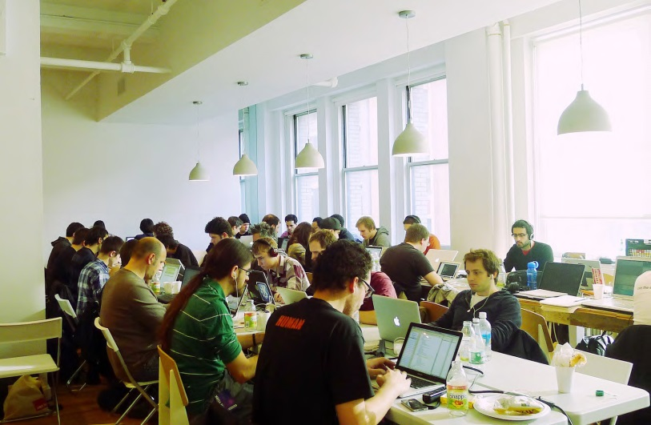
Co-working space

Slide 7
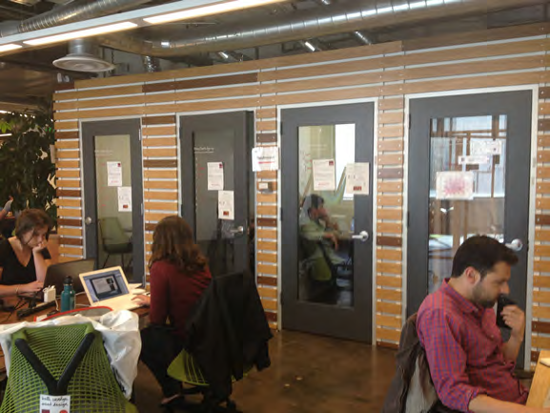
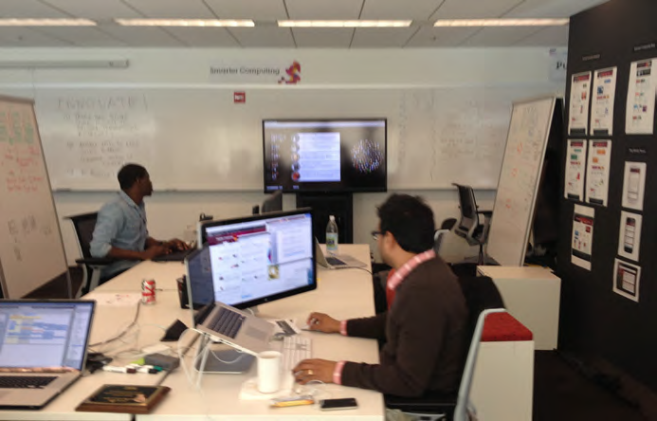
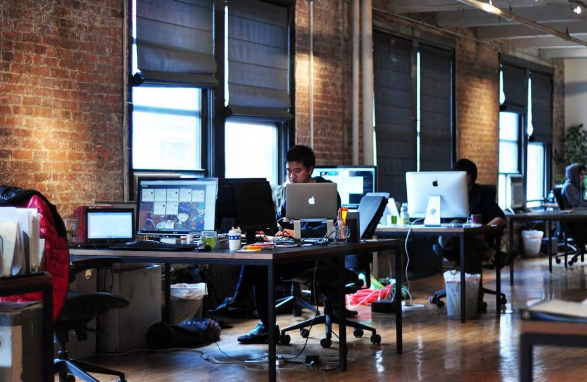
Company launch space

Slide 8
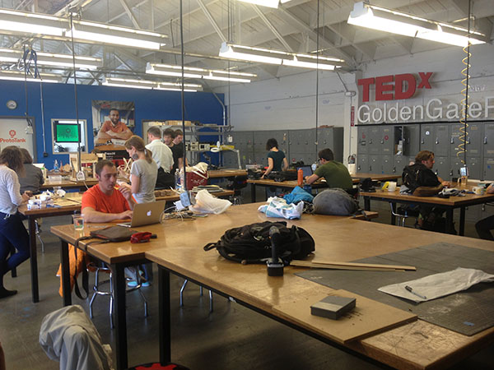
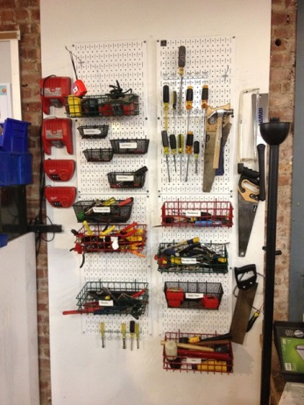
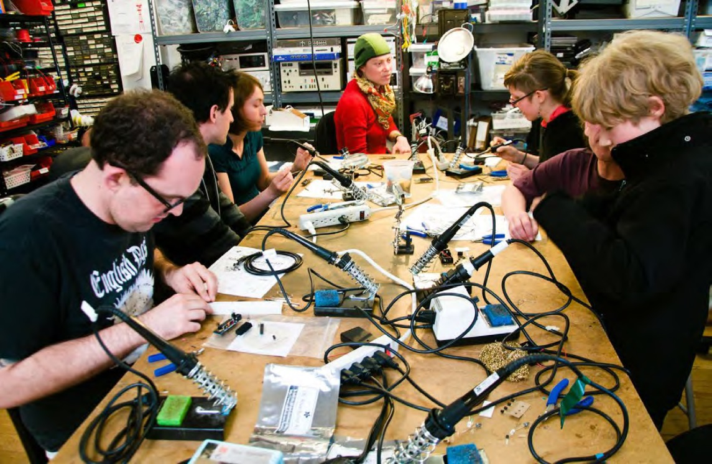
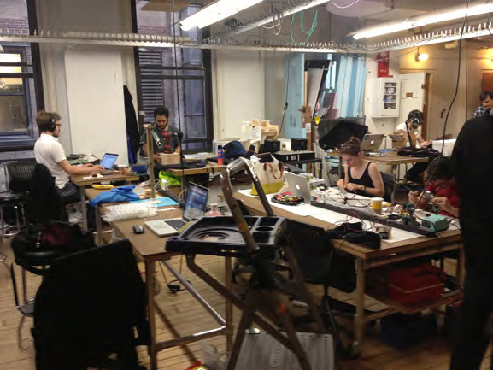
Fabrication/prototype space

Slide 9
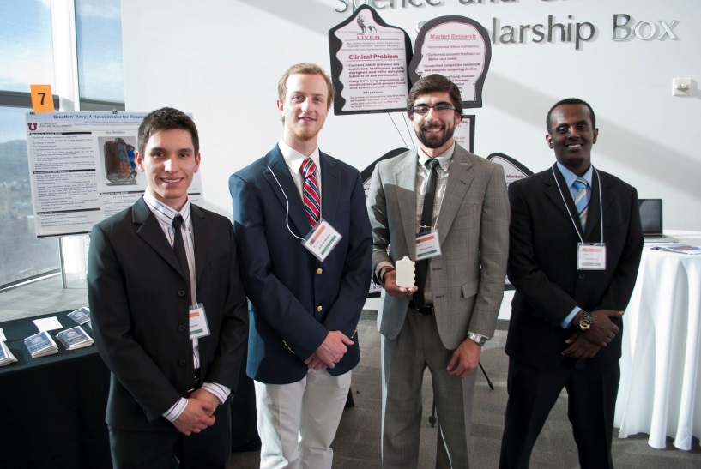
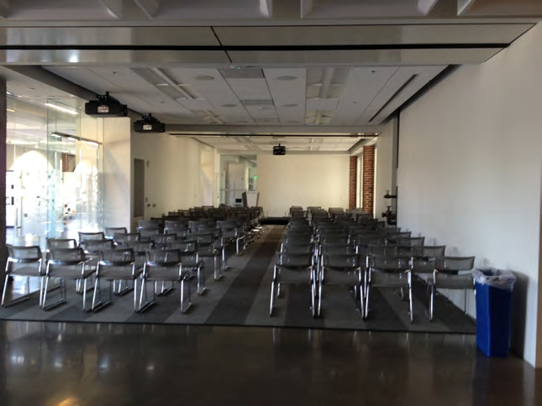
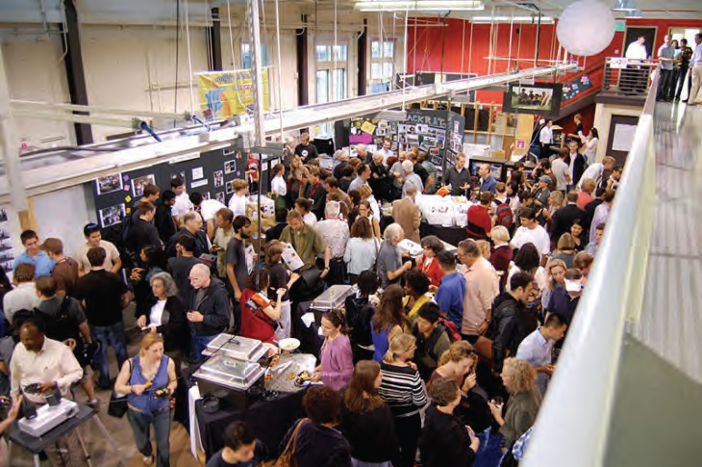
Event space

Slide 10
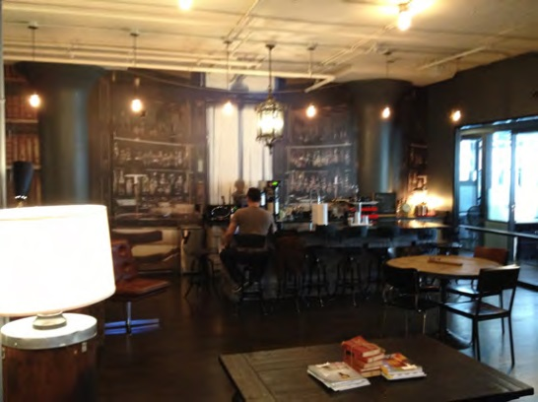
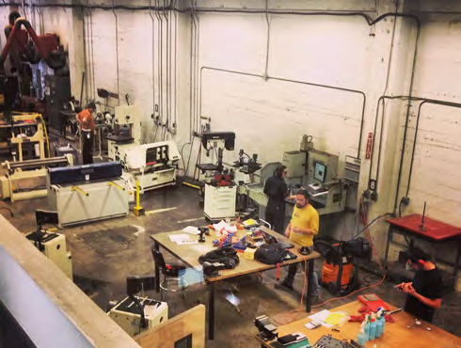
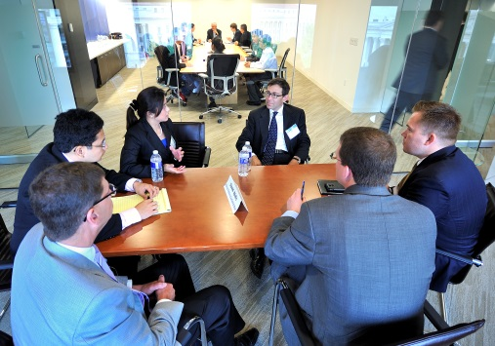
Garage floor naming opportunities
Café/lounge
Tech shop
Conference rooms

Slide 11
Garage naming

Slide 12
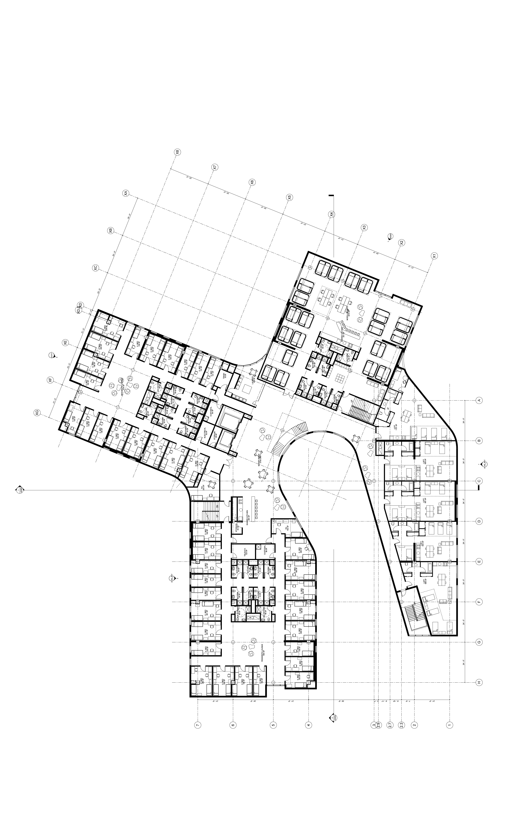
Residential floor
naming opportunities
Lounge
Deck
Residential Studio
Lofts

Slide 13
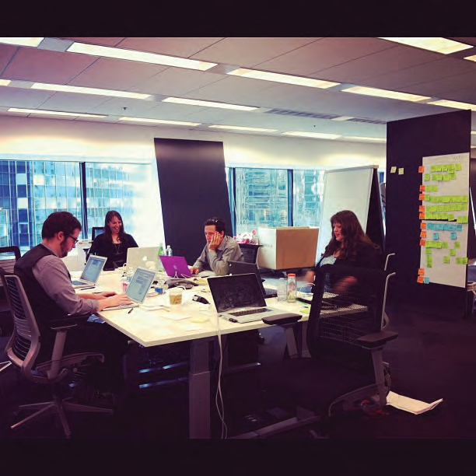
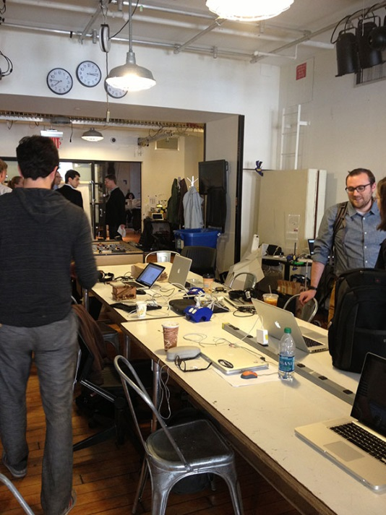
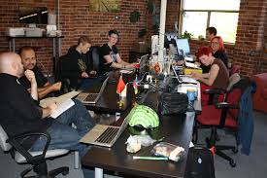
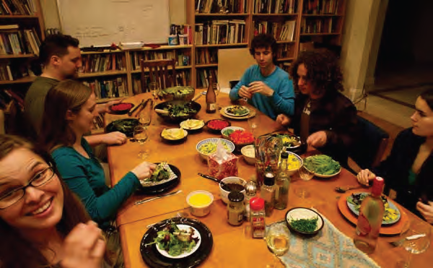
Residential Studio
Maker space
Digital media/ gaming space

Slide 14
Lassonde Studios
Program support & scholarships
Knowledge Studios - Student programing support $50,000/yr for 5 years plus scholarship(s) for student program manager
Garage floor naming opportunities
Conference room naming - $100,000 each
Café/lounge naming $500,000
Tech shop naming – $500,000
Garage naming - $3,000,000
Residential floors naming opportunities
Student loft naming - $50,000 each
Residential lounge - $100,000
Second floor deck naming - $250,000
Residential knowledge studios - $500,000 each
Residential floor naming - $1,000,000 each

Slide 15
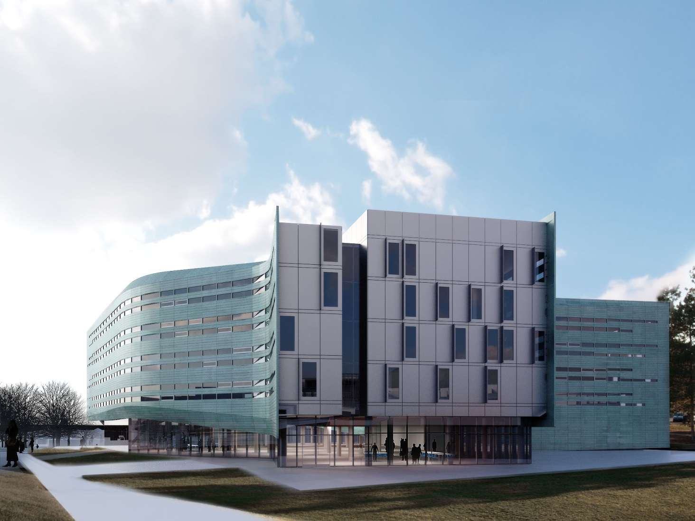
Lassonde Studios

